Slide 1
Java best practice
Nguyen Trung Hieu

Slide 2
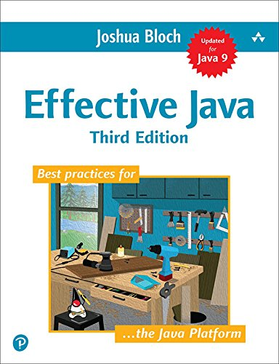
Special thanks
This presentation was made from the ideas of Joshua Bloch’s Efficetive Java 3rd Edition, 2018

Slide 3
Table of contents
Consider static factory method instead of constructors
Consider a builder when faced with many constructor parameters
Eliminate obsolete references
Prefer dependency injection to hardwiring resource

Slide 4
Consider static factory methods over constructors

Slide 5

The problem with constructors

Slide 6
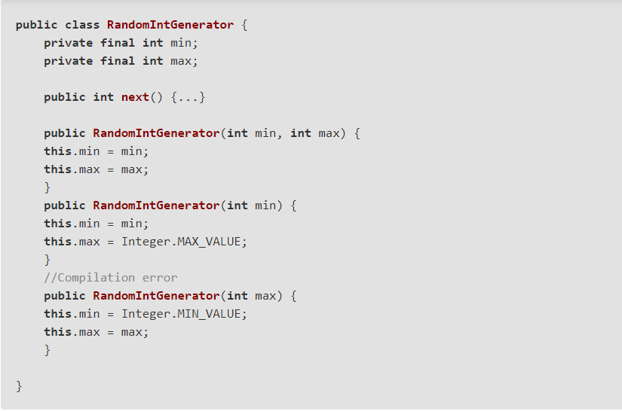
The problem with constructors

Slide 7
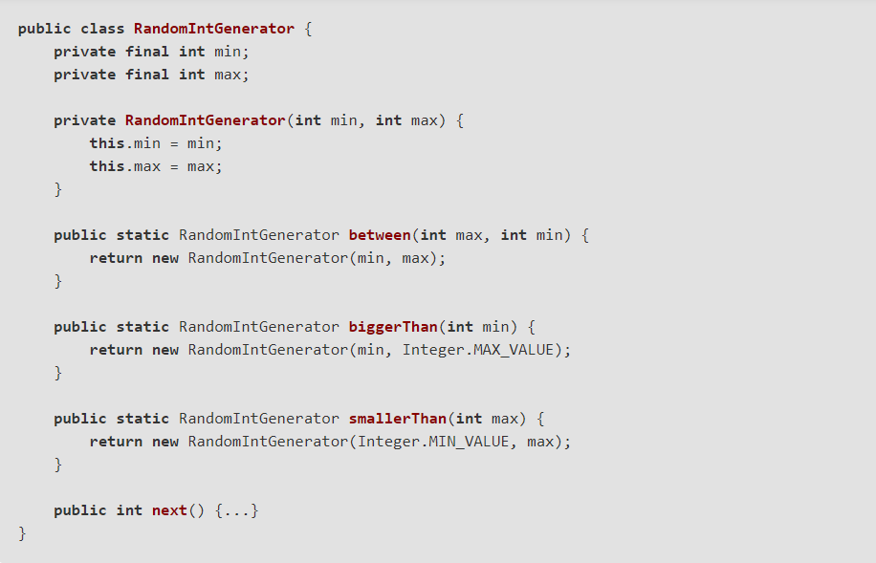
Solution - static factory method

Slide 8
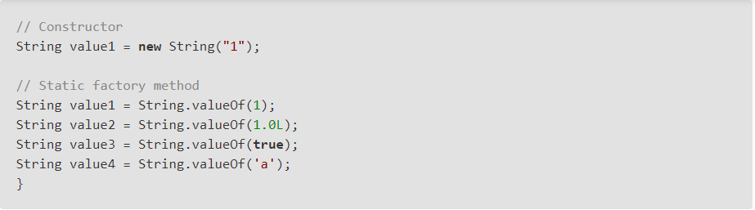
1- Constructors vs factory method

Slide 9
1- Why static factory methods?
Methods have name, Constructors not.
Returns same object from repeated invocations
Can return an object of any subtype of their return type
Move logic out of constructor

Slide 10
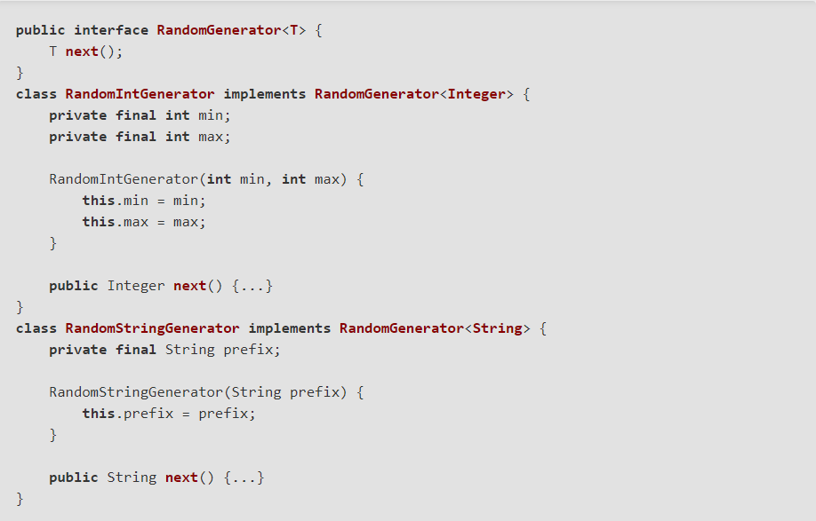
1- Why static factory methods?

Slide 11
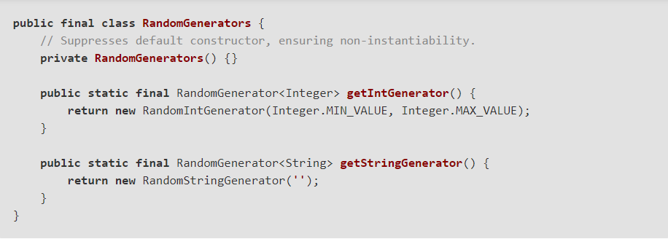
1- Why static factory methods?

Slide 12
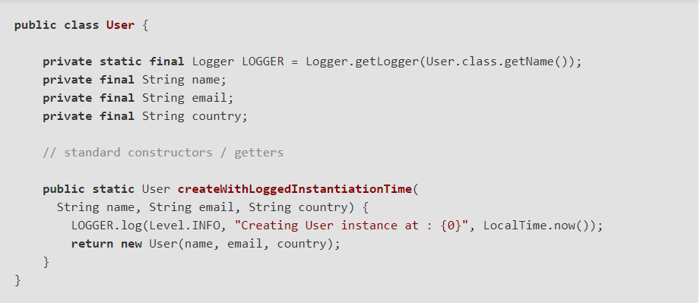
1- Why static factory methods?

Slide 13
1- Limitations
Classes without public or protected constructors cannot be subclassed
Difficult to find in document

Slide 14
Consider a builder when faced with many constructor parameters

Slide 15
The problem
Both static factory method and constructor does not scale well to large number of parameters
=> Traditional approach: Telescoping constructor pattern

Slide 16
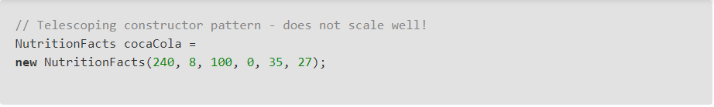
Telescoping constructor
When number of paramters increase, hard to write client code
Hard to read
=> Another solution: JavaBean pattern

Slide 17
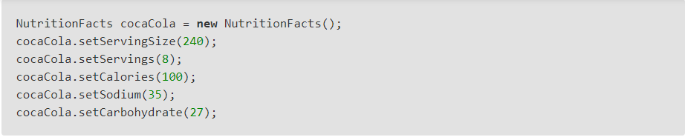
Java Bean pattern
Limitation: a JavaBean may be in an inconsistent state partway through its construction => Class must be mutable
=> Final solution: Builder pattern

Slide 18

Builder pattern
Easy to read
Work with immutable classes
Scale friendly

